Slide 1

Linear Regression-NVIDIA
Khaled Alrashed - Abdulrahman Alshehri

Slide 2
Introduction

Slide 3
Data Description
-yahoo finance
-10 different features
-4 categories (hardware industry , Gaming companies , Cryptocurrency , Others)
-1000 observation
-interval 2017-2021

Slide 4
NVIDIA
AMD
INTEL
Activision
EA
Oil
Gold
Nasdaq index
ETH-USD
BTC-USD

Slide 5
Data Exploration

Slide 6
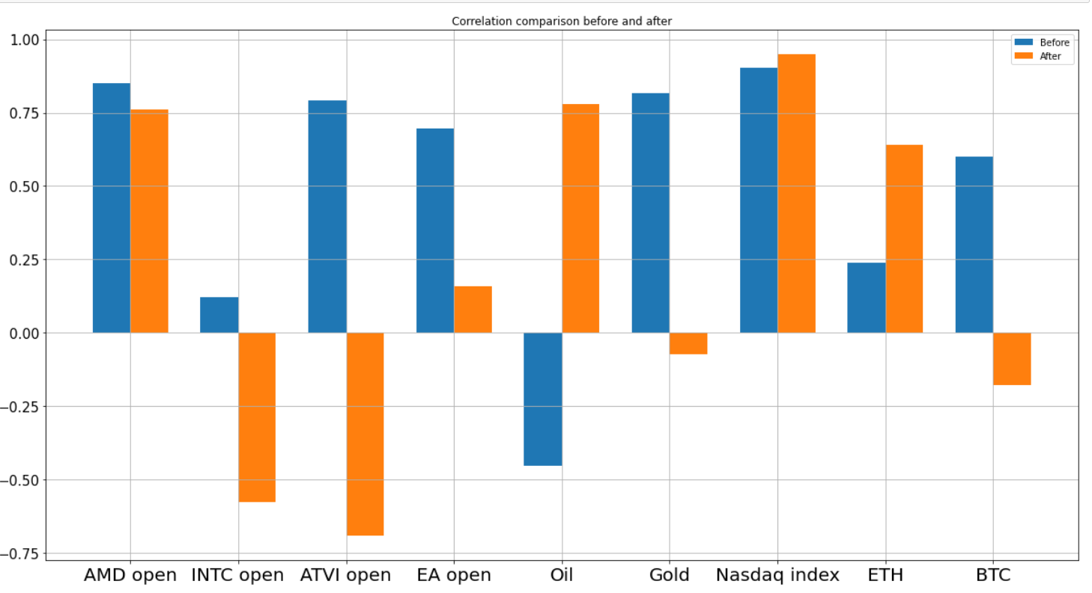
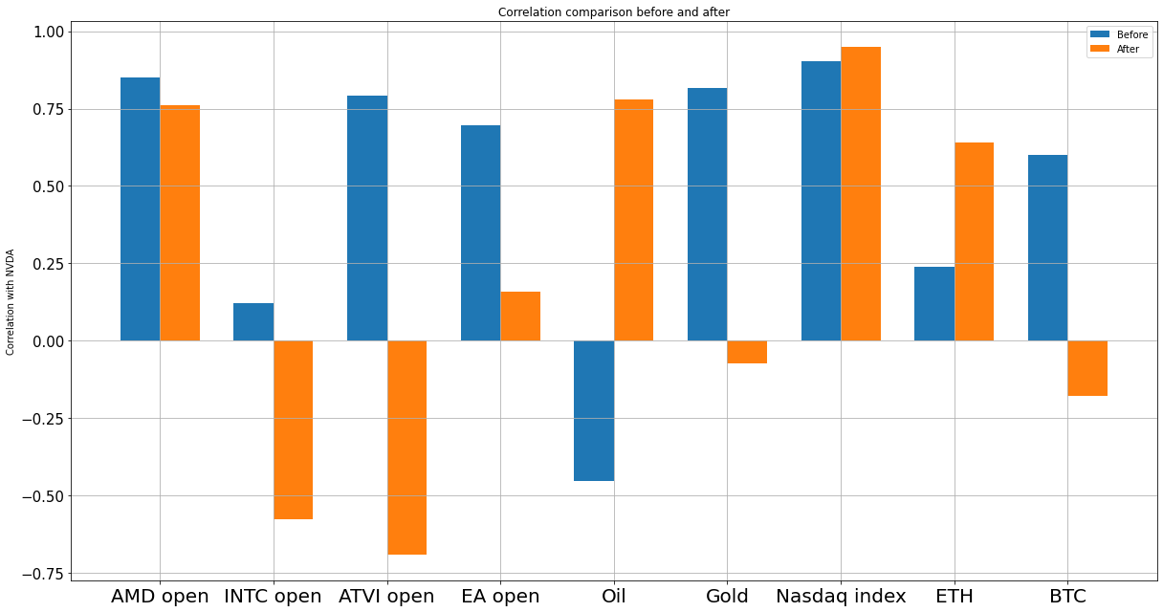

Slide 7
Results

Slide 8
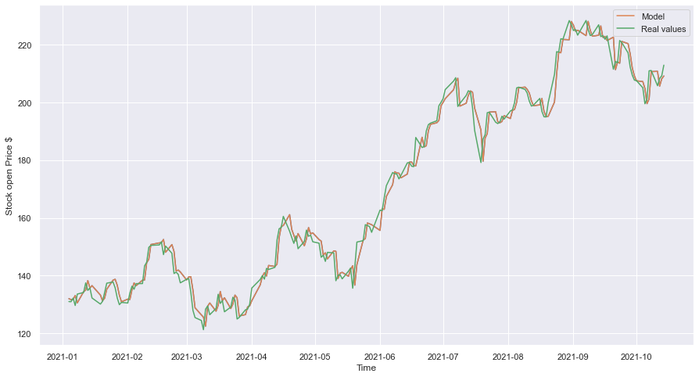
MAE = 2.74$

Slide 9
Conclusion
-Nasdaq index gives accurate performance for the stock
- the stock is following a positive trend

